Slide 1
Out-of-band extrapolation for Halo removal
Tan H. Nguyen

Slide 2
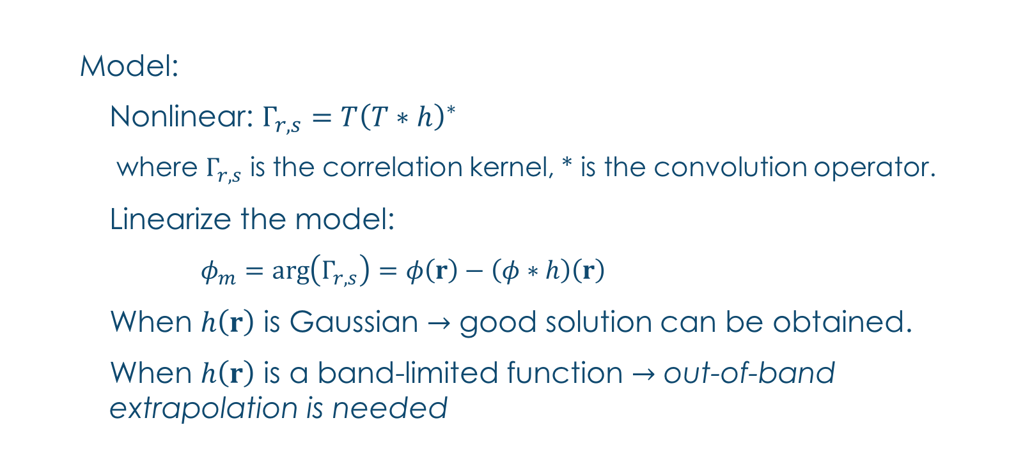
Recoverable frequencies of the current solver

Slide 3
An illustration
No need to recover
Not yet recover with the current code
Noise floor
Recoverable region

Slide 4
Problem statement
There is a non-recoverable region in the frequency domain that we are not able to recover yet.
Usable prior:
Total Variation (TV)
Non-negative
Finite support.

Slide 5
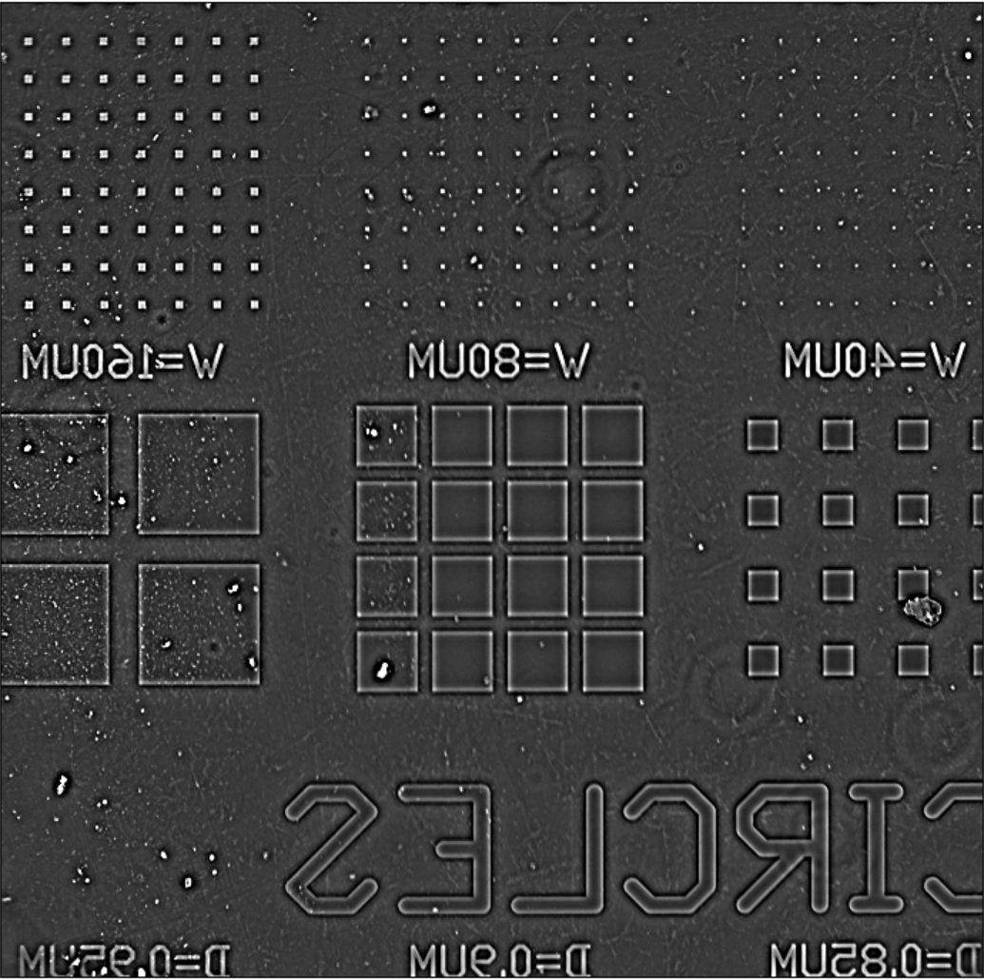
ORIGINAL IMAGE

Slide 6
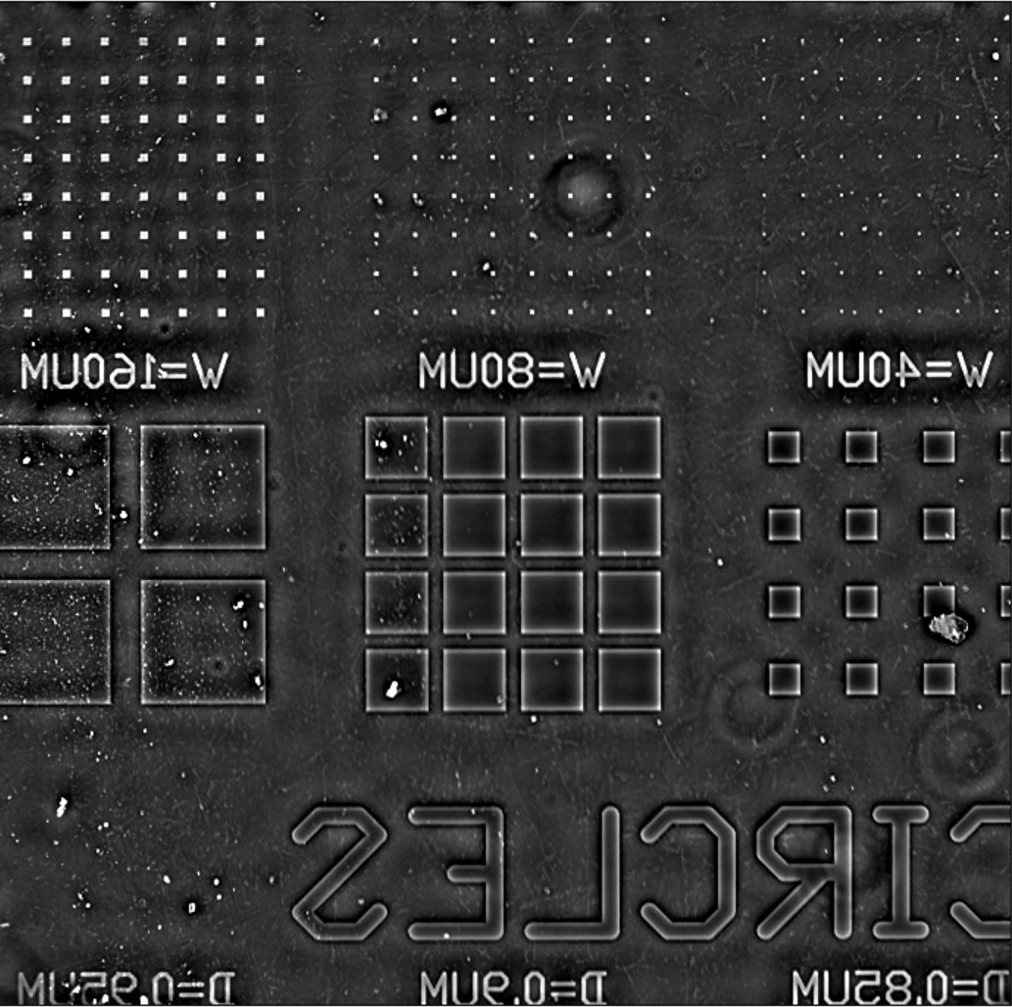
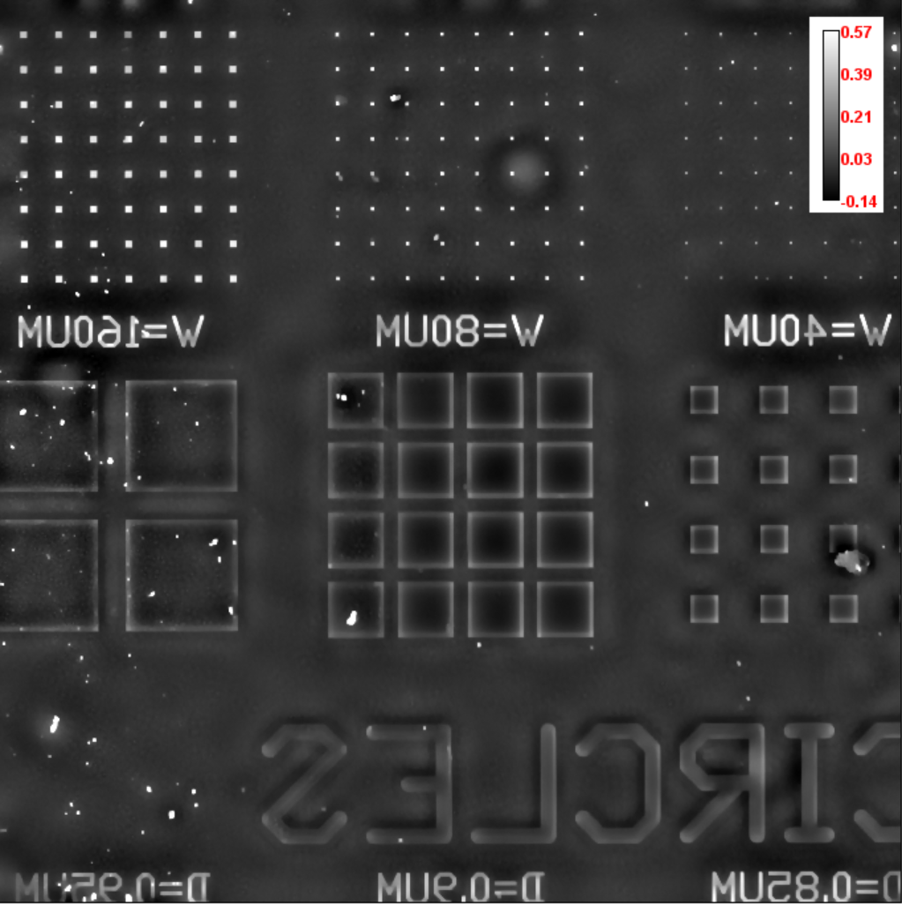
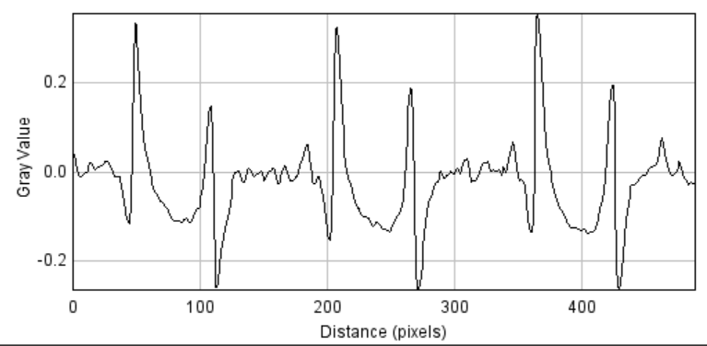
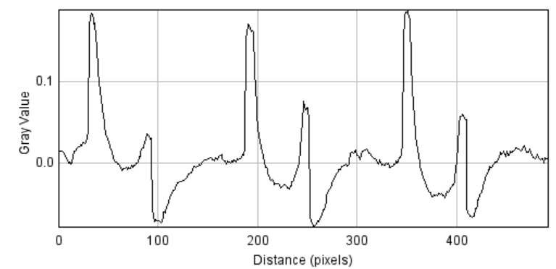
RESULTS – Total variation
With at 100 iterations

Slide 7
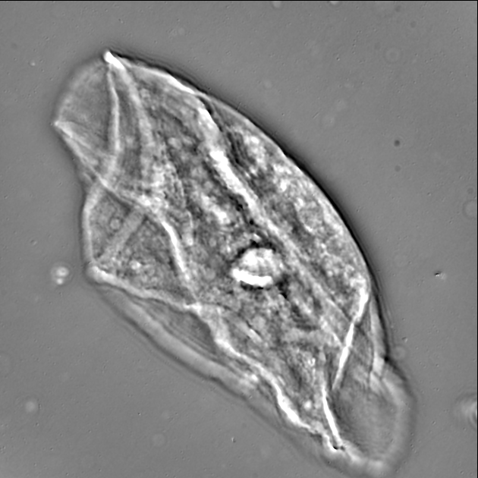
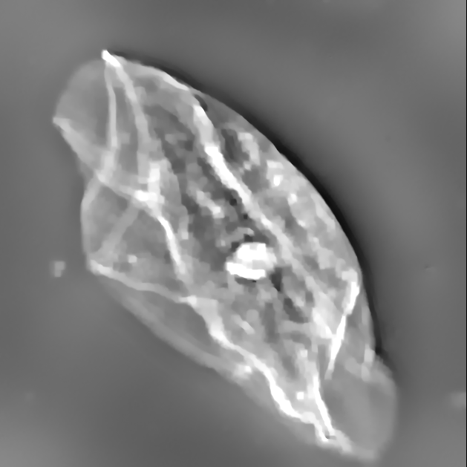
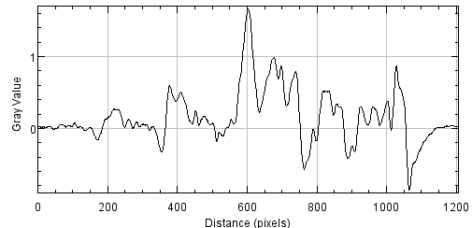
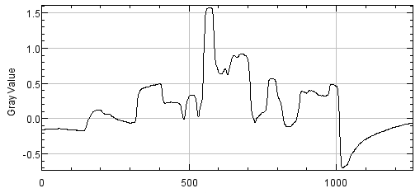
Total variation - More Results for EPFL
Original image
TV with
All figures has dynamic range of [-0.8, 0.8] rad.

Slide 8
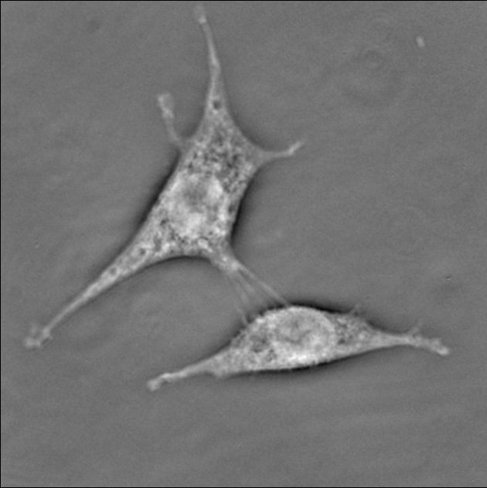
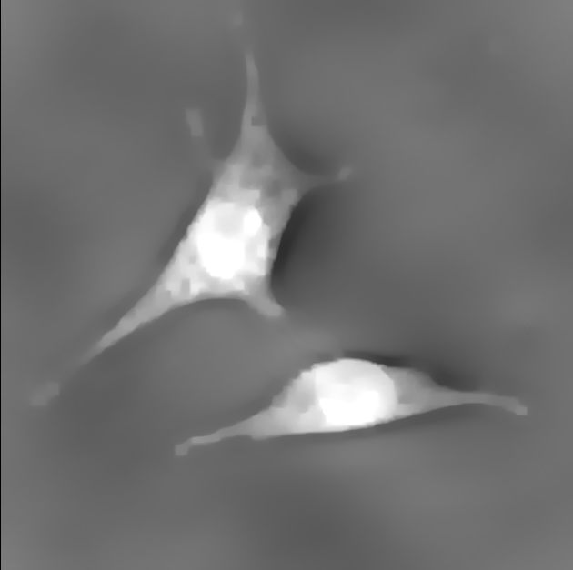
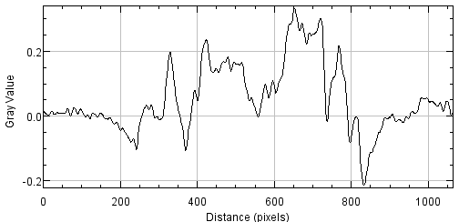
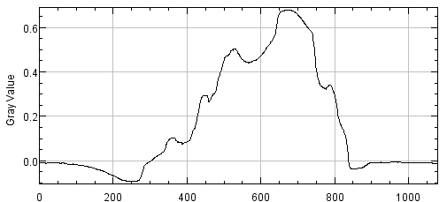
Total variation - More Results for epfl
Original image
TV with
All figures has dynamic range of [-0.4, 0.5] rad.

Slide 9
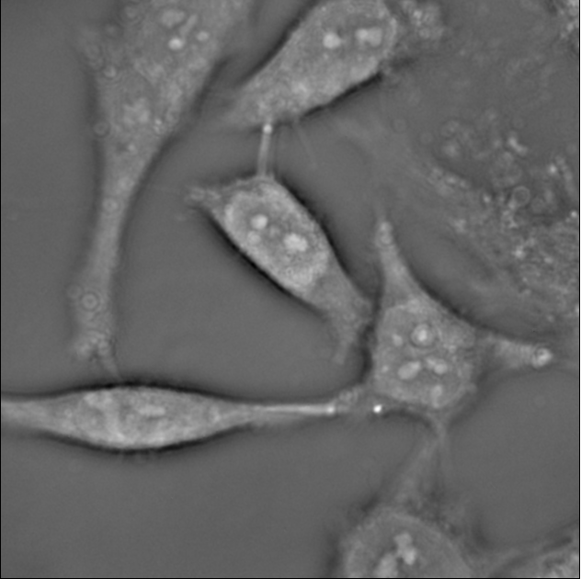
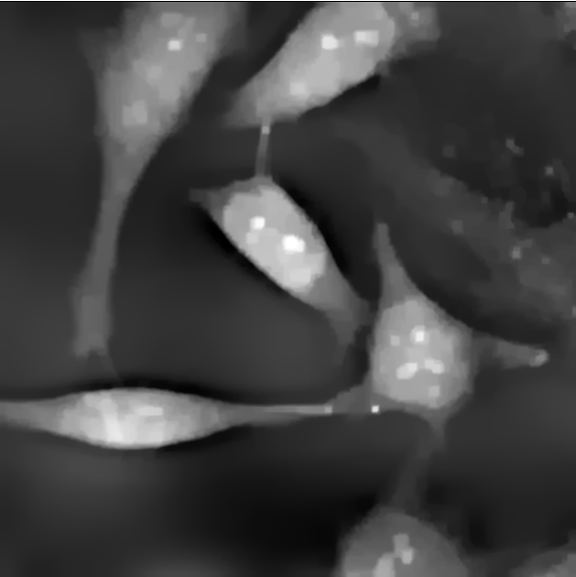
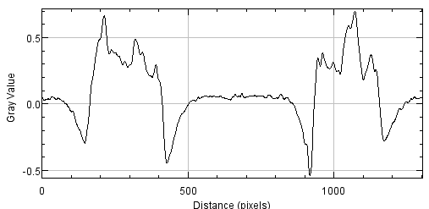
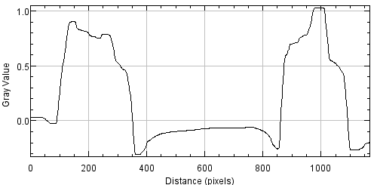
Total variation - More Results for epfl
Original image
TV with
All figures has dynamic range of [-0.4, 0.5] rad.

Slide 10
PROS and cons of total variation
PROS:
Take advantage of the fact that the object is smooth if the magnification is large enough.
Several solvers are available.
Can be used to extrapolate frequency information surrounding the base band.
CONS:
Attenuate the high-frequency information in the reconstruction.
Cannot differentiate between high-frequency information vs. noise to suppress.
Our true image may not be actually smooth but closed to smooth => Information in the measurable band should be consistent.

Slide 11
PROPOSED METHOD
No need to recover
Measurement
Initialization for the TV solver
TV solver
(do not let this converge all the way)
Assignment
Frequency replacement

Slide 12
ORIGINAL IMAGE

Slide 13
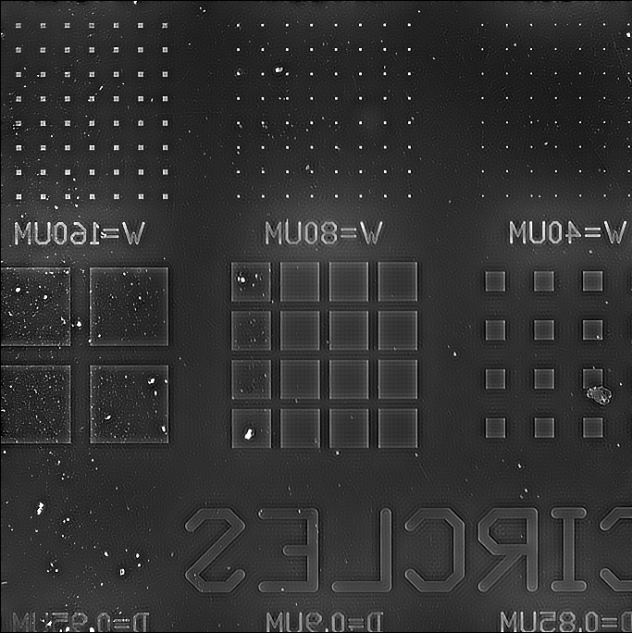
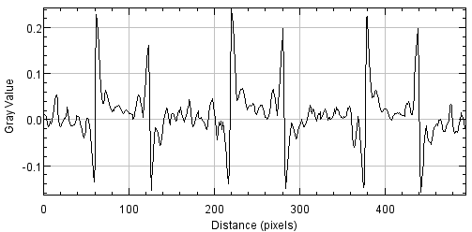
RESULTS
With at 100 iterations

Slide 14
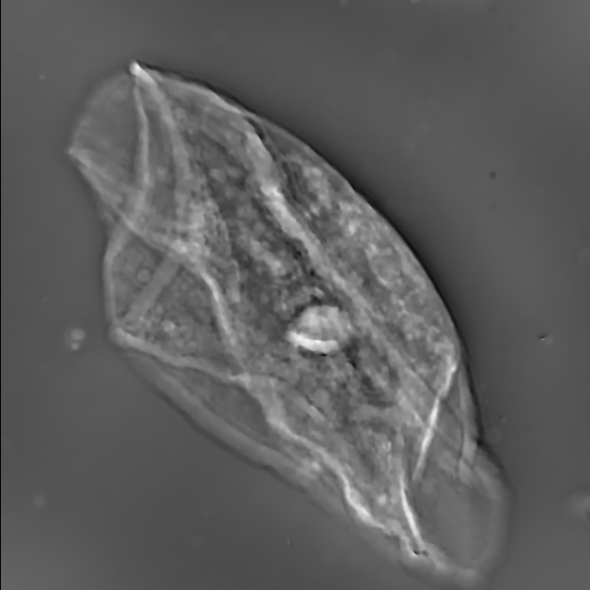
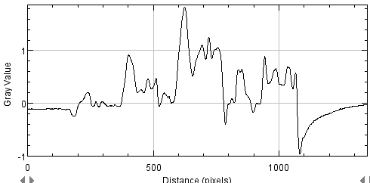
Results
Original image
TV with
New method, , TV: #iter = 20, # outer loops =3
All figures has dynamic range of [-0.8, 0.8] rad.

Slide 15

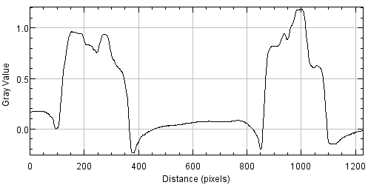
Total variation - More Results for epfl
Original image
TV with
All figures has dynamic range of [-0.4, 0.5] rad.

Slide 16
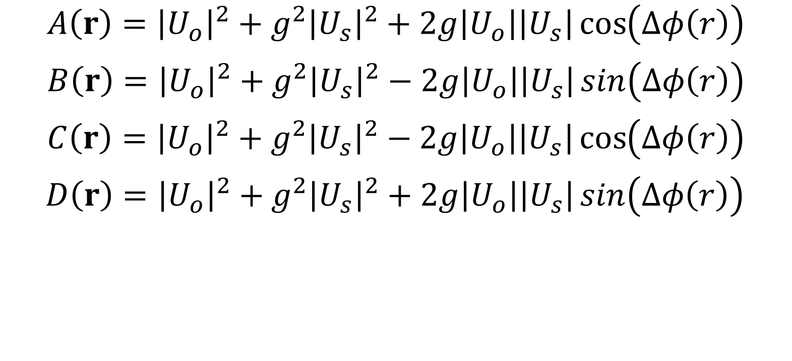
What else we can take advantage of?

Slide 17
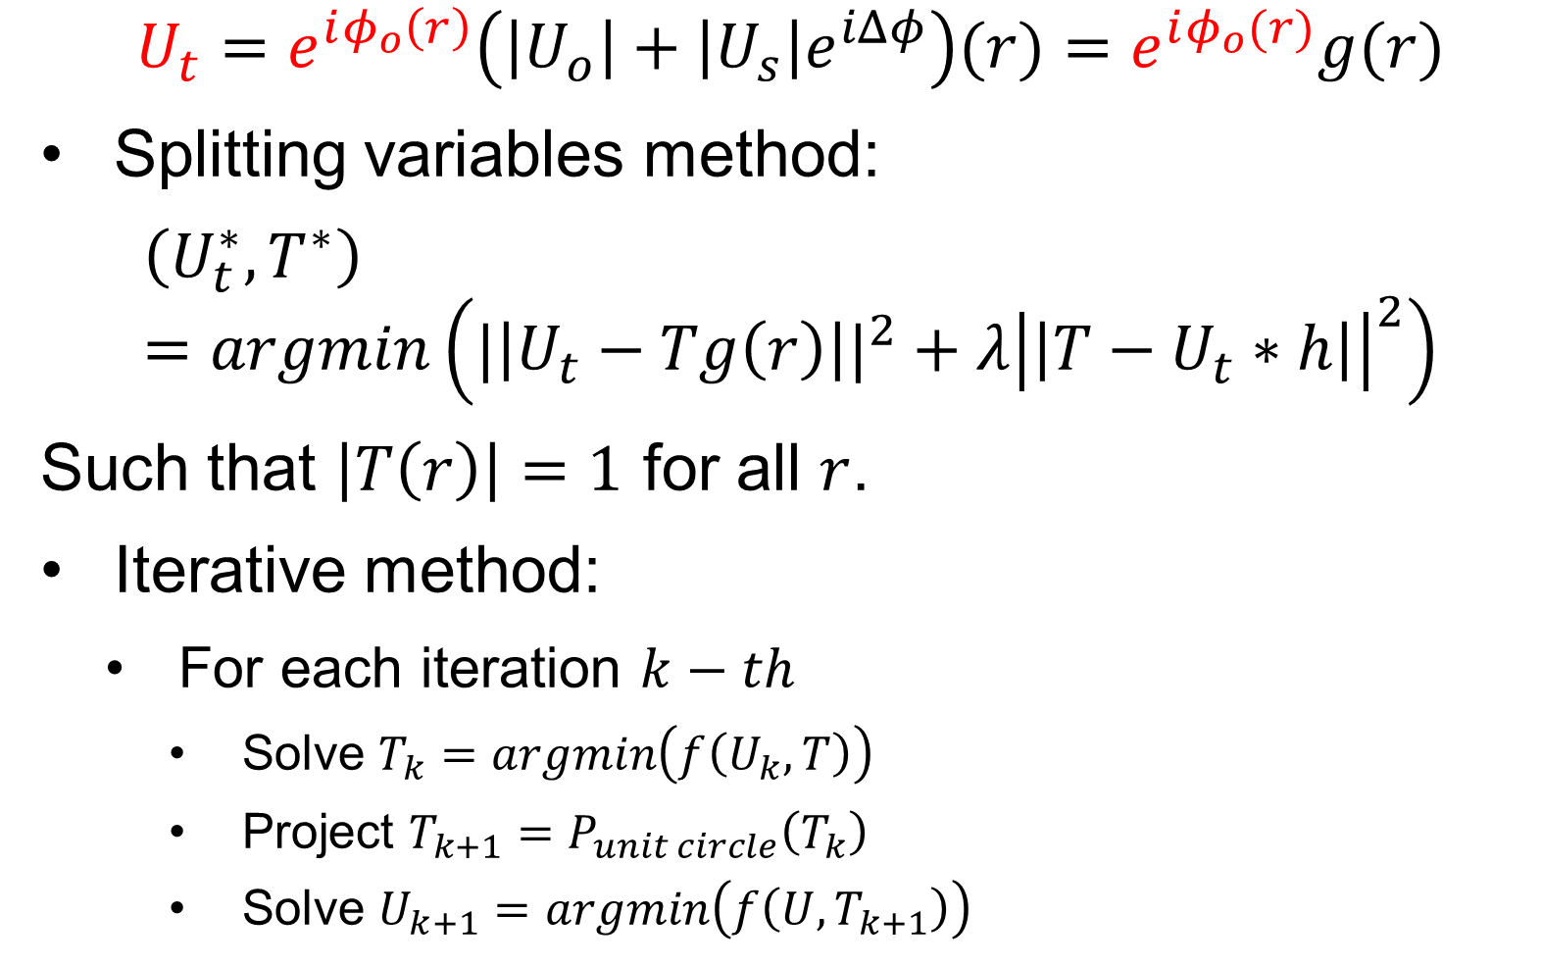
What else we can take advantage of?

Slide 18
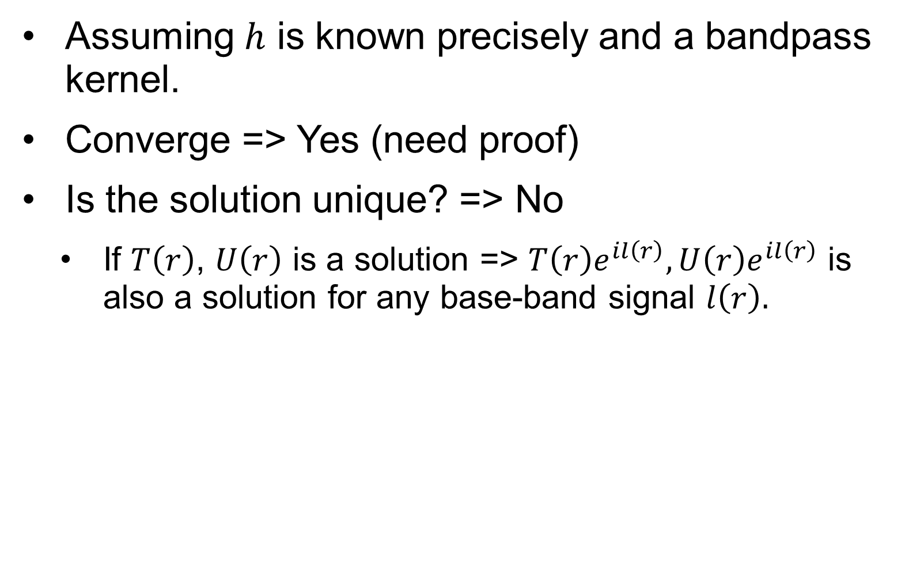
Performance analysis

Slide 19
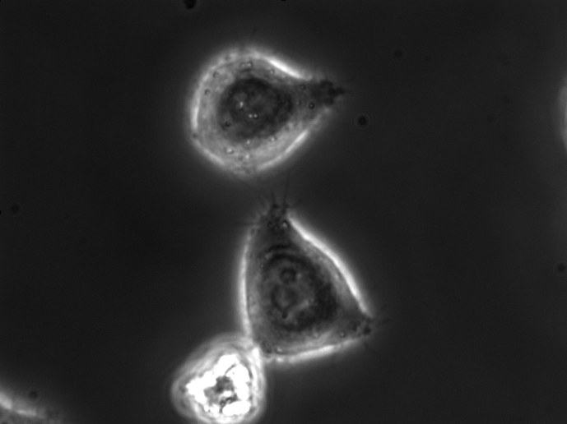
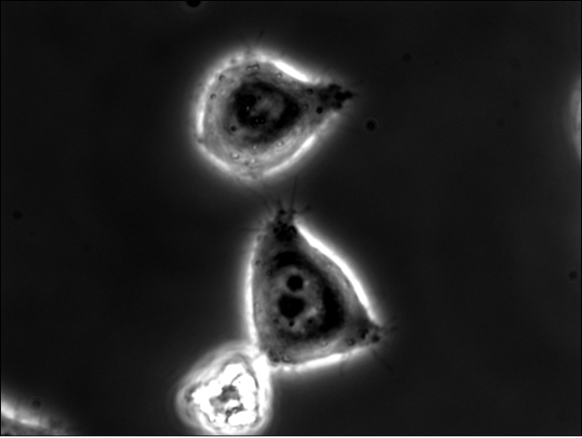
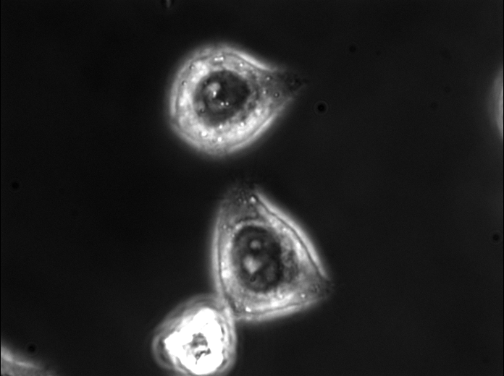
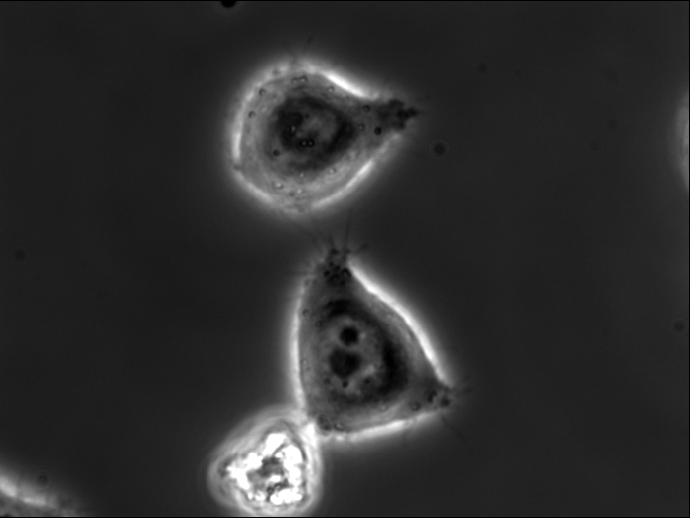
A, B, C, D
A
B
C
D

Slide 20
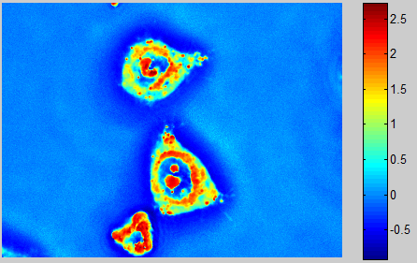
SLIM image

Slide 21

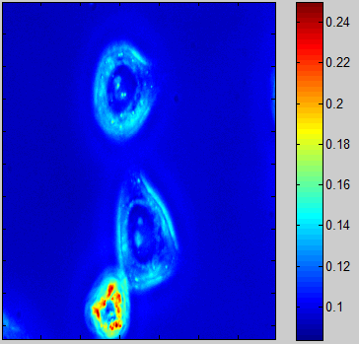
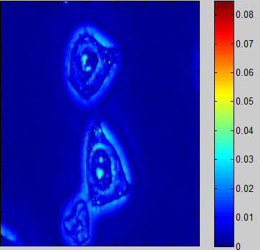
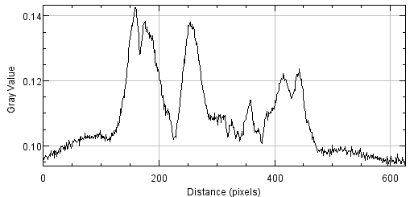
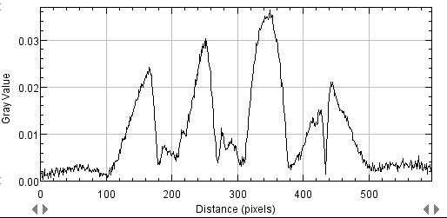

Slide 22
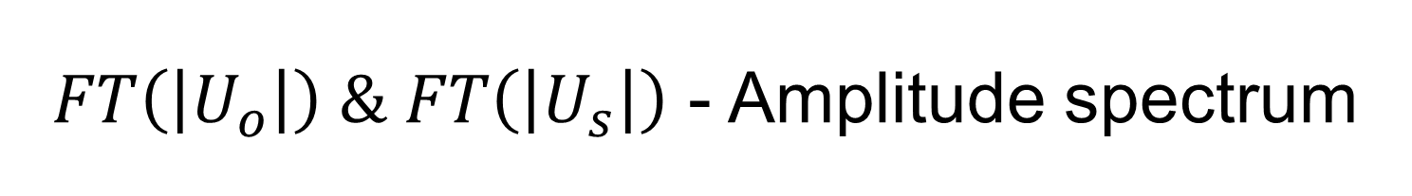
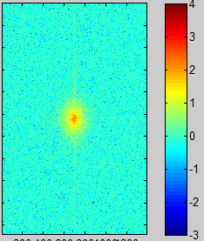
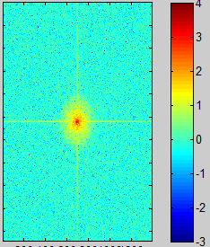
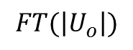
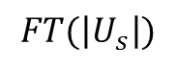
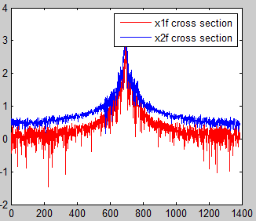

Slide 23
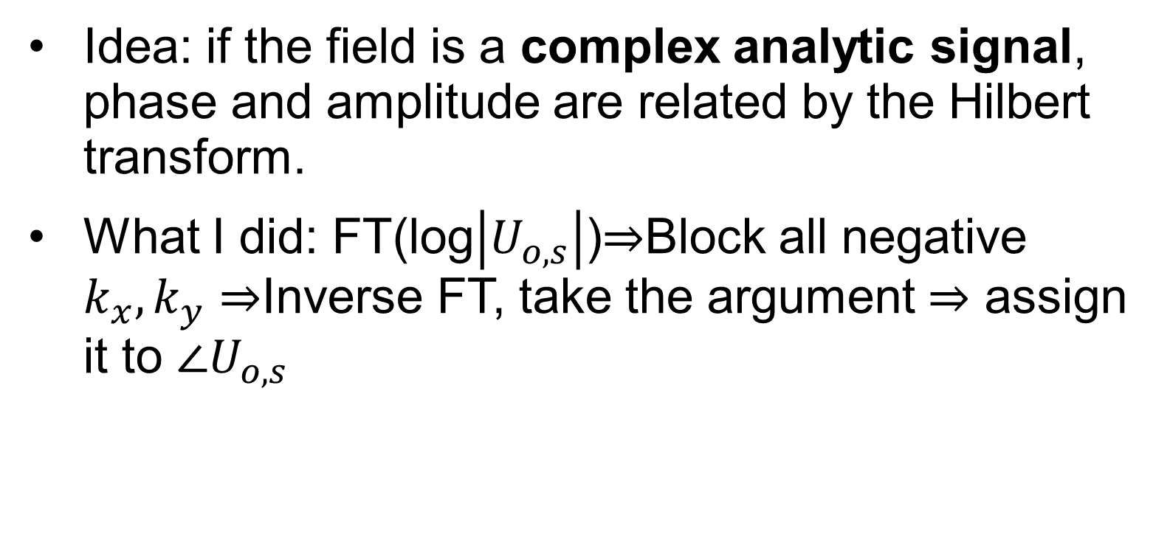
Some results on Hilbert transform

Slide 24
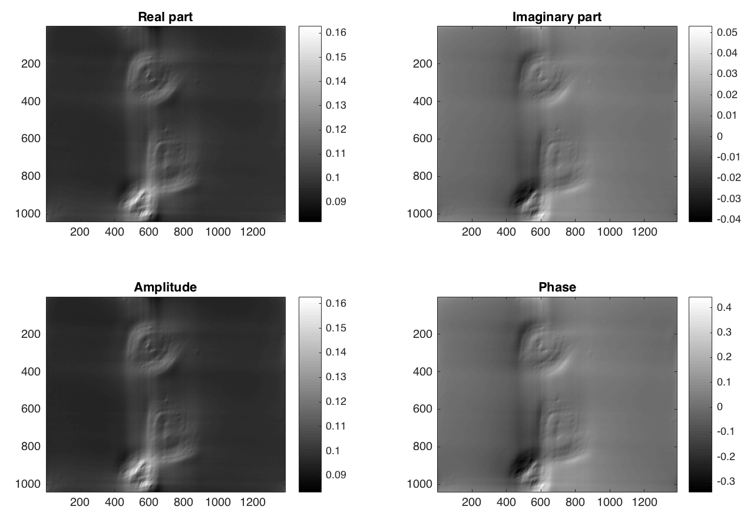
Some results on Hilbert transform
Hilbert

Slide 25

Kramer-Kronig’s relation

Slide 26

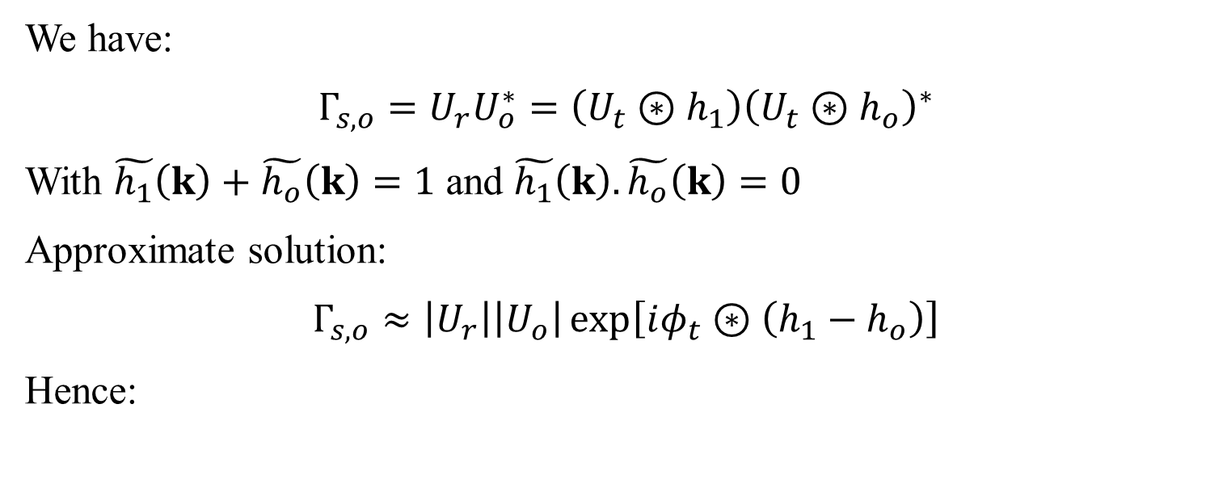

Slide 27
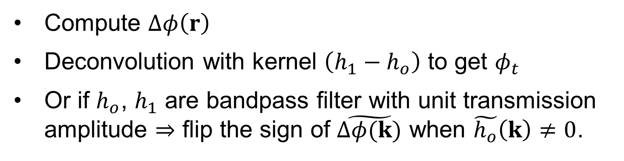
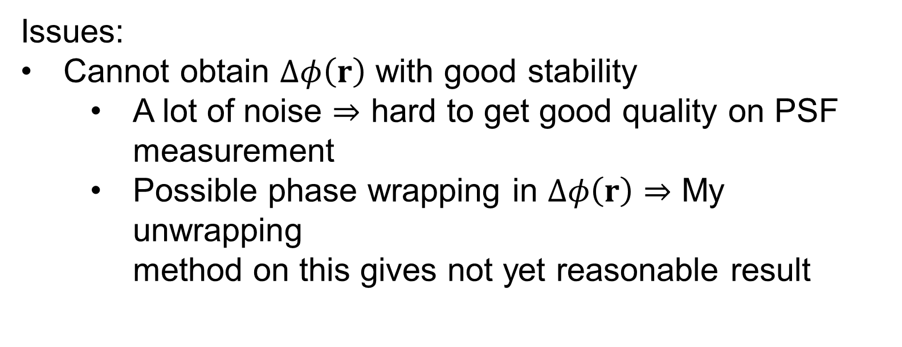
Computing procedure

Slide 28
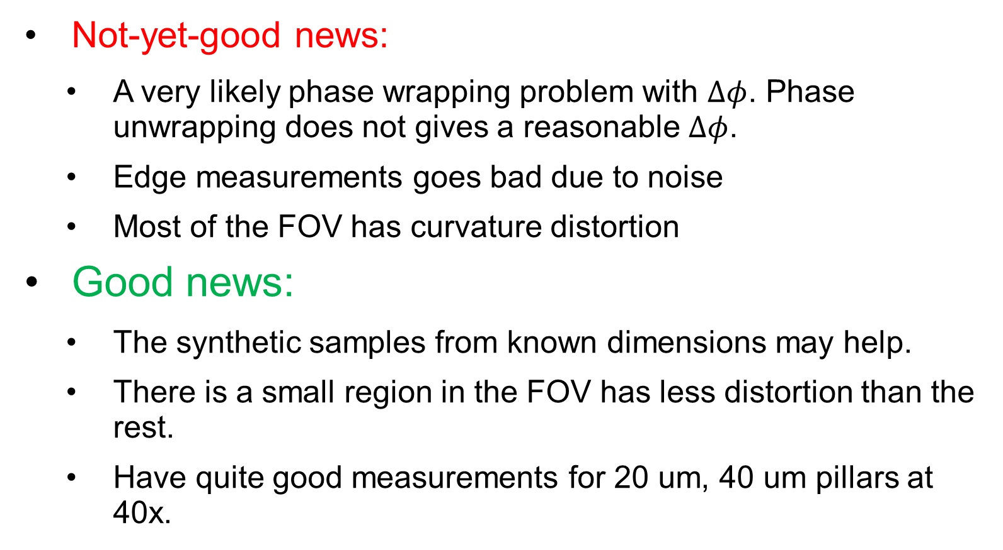
Good vs. Not-yet-good news

Slide 29
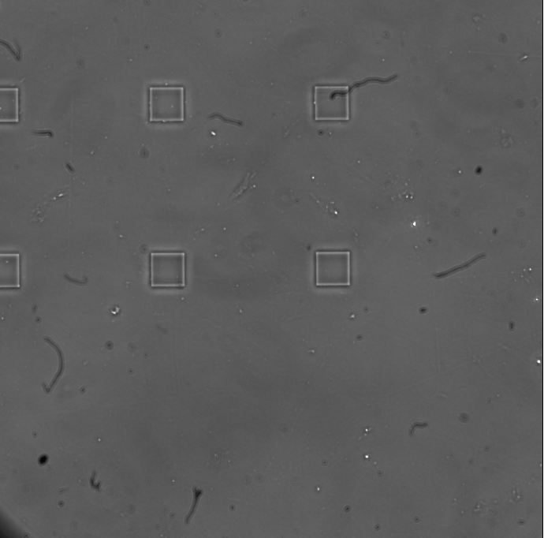
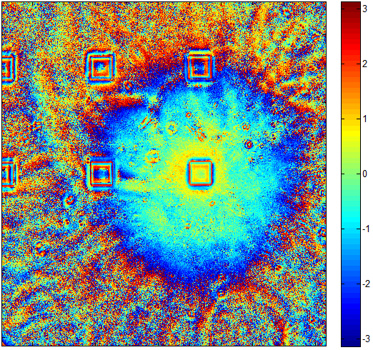
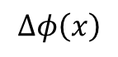


Good vs. Not-yet-good news (cont.)
(*)
(a)
(b)
20 um quartz at 40x Ph2
These phase wrapping
does not look right.
(c)
(d)
(*): Mikhail suggest checking the correction lens of the SLIM box for this aberration

Slide 30




(a)
(b)
20 um quartz at 40x Ph2
(c)
This are wrong due
to non-symmetry.
May have a focus issue here!

Slide 31







FT
Amplitude spectrum (log scale)
Point-wise division
FT
Amplitude spectrum (log scale)
These extrema are unreal
caused by zeros in the spectrum of the synthetic obj.

Slide 32
Reconstruction results
Not good reconstruction so far using any method of the above.
Still working on it….

Slide 33

Plans

